Slide 1
Project Archive Web Application

Slide 2
Why did I choose this?

Slide 4
STACK

Slide 5




Firebase
(Database System)
Express.js
(Back-end web framework)
Angular.js
(Front-end web framework)
Node.js
(Back-end runtime environment)

Slide 6
Web Architecture

Slide 7






Web Architecture
Web Application Architecture
Client side
HTTP Request
Request
API
Angular.js
Bootstrap / CSS
Chart.js
Response
Express.js / Node.js
Response
Web Server
Browser
HTML
Front-end
Firebase Storage
Firestore
File Storage
Database
Back-end
Platform as a Service (PaaS)

Slide 8
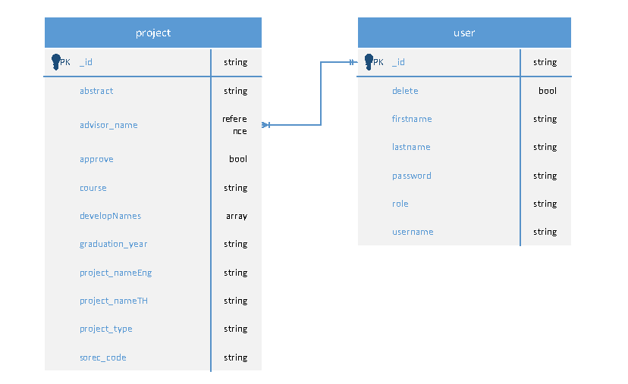
ER Diagram

